Slide 1
Learning & Development Enabling development, Impacting growth…
Cognos 11 (IBM Cognos Analytics) – Training
Legacy Studios – Analysis & Event Studio

Slide 2
Module Objectives :
Analysis Studio
What is Analysis Studio ?
Analysis Studio simple report
Event Studio
What is Event Studio ?
Simple Event Creation.
Schedule and Trigger Events Studio Agents.

Slide 3
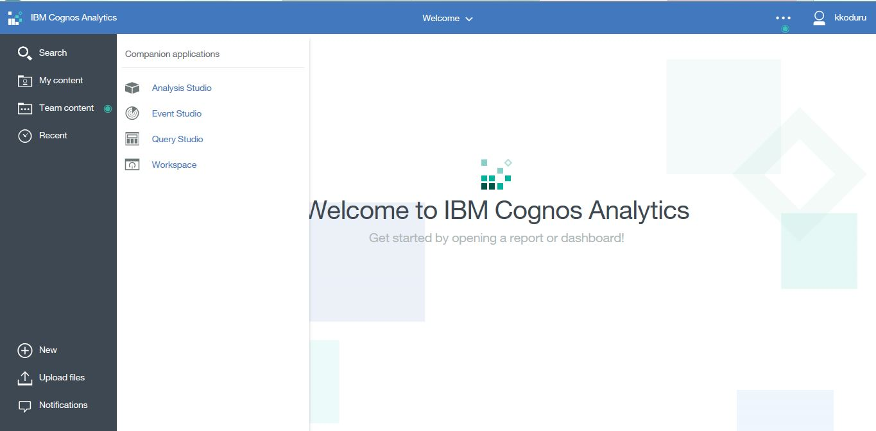
Analysis Studio
User Interface
Access the Analysis Studio tool from the Cognos Analytics web portal.
Notes:
3
3

Slide 4
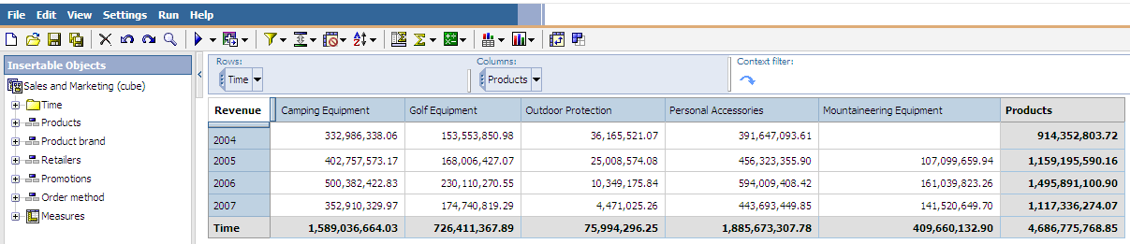
Analysis Studio
What is Analysis Studio?
A web based reporting tool in which users can explore and analyze data from different dimensions of their business. Users can also compare data to spot trends or anomalies in performance. IBM Cognos Analysis Studio provides access to dimensional, online analytical processing (OLAP), and dimensionally modeled relational data sources.
Key Capabilities
Self Service Reporting: find and focus on items that are important to your business
Share findings: User can create his own reports and share them in different formats.
Benefits
understand trends and anomalies
compare data, such as details to summaries, or actual results to budgeted results
assess performance by focusing on the best or worst result
establish relative importance using calculations such as growth or rank

Slide 5
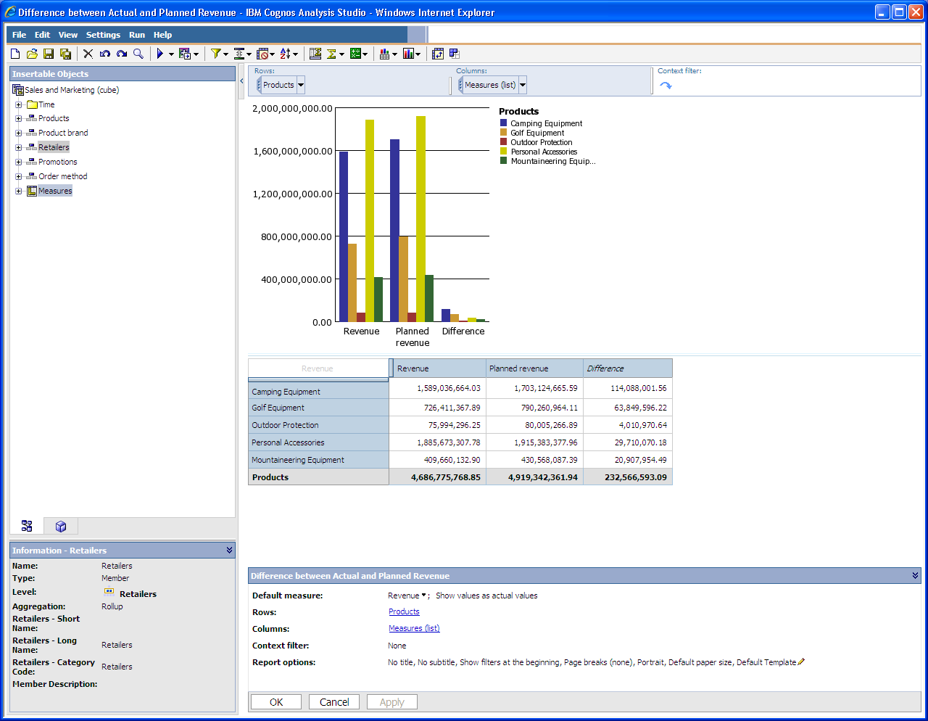
Analysis Studio
Overview Area
Insertable Objects Pane
Work Area
Properties Pane
Information Pane

Slide 6
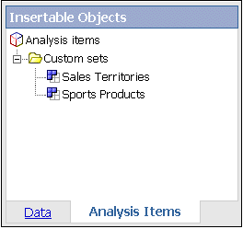
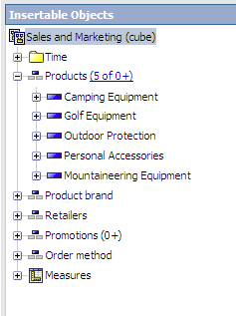
Analysis Studio
The Data Tree displays a dimensional view of your data, organized into dimensions, hierarchies, levels, and measures.
The Analysis Items tab contains items created during analysis, such as custom sets and named sets
Notes:
6

Slide 7
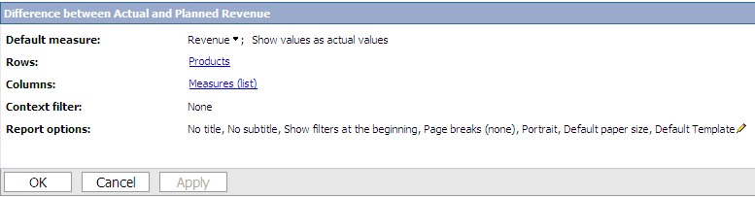
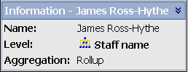
Analysis Studio
Information Pane
The Information pane displays the name, level , attributes, and aggregation associated with the selected item in the data tree
Aggregation types for measures are sum, count, count distinct, count nonzero, and none.
Aggregation types for other items are rollup and computed.
Properties Pane
The Properties pane provides a comprehensive view of the cross tab or selected set in the work area.
Specify the number of items to show
Create a user-defined filter
Sort data
Unhide data

Slide 8
Analysis Studio
Exploring Data
Work area by default consists of a crosstab.
Each box in the Rows area and Columns area represents one or more sets in the crosstab.
Data exploration can be done by dragging and dropping the elements from the data tree to either in the crosstab or the overview area.
In the Overview Area,
Stacked sets appear as a single box labeled Combination.
Selection-based set appears as a box with list appended to the label.
The context specifies is applied as a whole to the work area.
For focused analysis we can have following features as
Drilling up and down
Going to another report or package
Showing values as percentages
Sorting values
Showing values graphically in charts

Slide 9
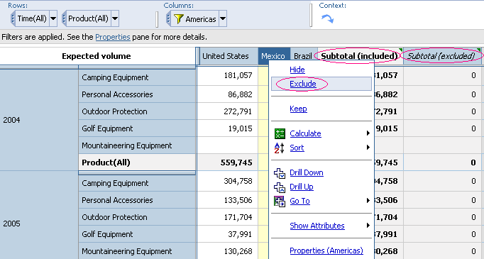
Analysis Studio
Unnecessary data can be removed using
Filter values to displays only the data you want to view
Exclude items to eliminate unwanted information
Apply a top or bottom rule, when analyzing a large amount of data
Create a user-defined filter to limit the items displayed to those that meet a specific criteria
Remove rows or columns containing only missing value
The different types of context filters can also be applied
Zero Suppress Filter
Top/Bottom Filter
Exclude
User-defined Filters

Slide 10
Event Studio
In Event Studio, you set up agents to monitor your data and perform tasks when business events or exceptional conditions occur in your data that must be dealt with.
When an event occurs, people are alerted to take action. Agents can publish details to the portal, deliver alerts by email, run and distribute reports based on events, and monitor the status of events.
For example, a support call from a key customer or the cancellation of a large order may trigger an event, sending an e-mail to the appropriate people

Slide 11
Q & A

Slide 12
Thank You
Review Date | 14-July-2016
Version | 1.0
Next Review Due | 14-July-2017

